Slide 1
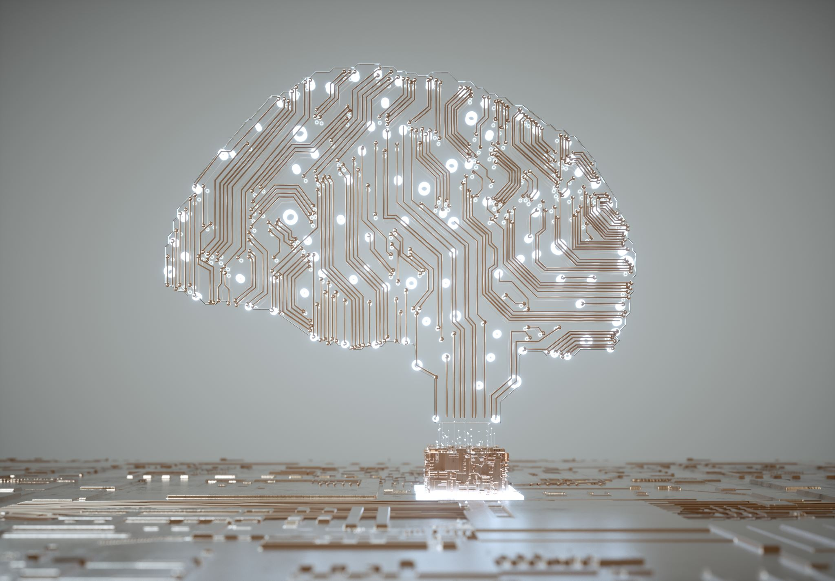
Fundamentals of Artificial Intelligence and Machine Learning
Module 1

Slide 2
Course Learning Objectives
Understand the basics of Machine Learning and Data-Analytic thinking in a business context.
Learn to build and evaluate simple models for decision-making.
Solve business problems to classification tasks.
Effectively communicate AI concepts and insights in the workplace.
Notes:
Understand the basics of Machine Learning and Data-Analytic thinking in a business context.
Foundational knowledge of machine learning concepts
Focus on how AI can be applied to improve decision-making
Learn to build and evaluate simple models for decision-making.
Explore basic machine learning models
Decision Trees
Linear Regression
Key Business Metrics
Accuracy
Precision
KPI
Solve business problems to classification tasks.
Review case studies and datasets to apply AI in business contexts
Learn to answer questions like
Will this credit card prospect default or no? (Binary classification)
How much will this customer spend this year? (Regression)
What characteristics do my most profitable customers share?
(Clustering/similarity Profiling)
Effectively communicate AI concepts and insights in the workplace.
Discussions on how machine learning models can be applied to a specific business problem
Focus on what model to use in each scenario, how to evaluate it, and interpret results
Discussion on the ethics of machine learning models on topics like bias, privacy, and misuse

Slide 3

Introductions
Victoria has a diverse background in software development and music education. She holds a Bachelor of Music degree from Temple University and a Master of Science in Business Analytics from Rutgers University, where she graduated Summa Cum Laude.
With 5 years of experience at Miles IT as Software Development Lead and Project Manager, Victoria’s expertise lies in system architecture, machine learning, and data analytics. She excels in leading teams and is passionate about using technology to create impactful solutions while remaining committed to continuous learning.

Slide 4
About Yourself
What are you hoping to gain from this course?
What brought you to the WFD program? What is the next step of your career?
A hobby or fun fact!
Notes:
Introduce Yourself to the Class!
What do you like to be called
Something about yourself – if you can’t think of anything, answer one of the above questions

Slide 5
First Session
Data Analytics vs Data Science
Machine Learning and AI
AI in Everyday Technology
AI in Business
Ethical Considerations – Discussion
Setting up Machine Learning Environment
Theory and Practice
Classification
Decision Trees
Nearest Neighbors Algorithm
Famous Iris Data Set

Slide 6
Types of Analytics
Descriptive Analytics
Understanding past events by summarizing and interpreting historical data.
Diagnostic Analytics
Attempting to understand why something happens. Identifies the root causes of specific events or patterns contributing to certain outcomes.
Predictive Analytics
Uses historical data and statistical models to forecast future outcomes and trends.
Prescriptive Analytics
Focuses on finding the best course of action for achieving desired objectives and outcomes.

Slide 7

Data Analytics vs Data Science

Slide 8
Data Analytics
Interpreting data to identify trends, patterns, and insights.
Helps in business and decision making by answering specific business questions.
Focus is on descriptive and diagnostic data, frequently dealing with historical data, and performing statistical analysis.
Tools include Tableau, and Power BI for visualizing and reporting data.

Slide 9
Data Analytics - Roles and Contributions to Business
Identifying Insights and Trends
Example: Analyzing sales data to identify top-performing products.
Supporting Decision-Making with Data
Example: Analyze campaign performance and determine which channels or strategies were most effective.
Tracking and Measuring KPIs
Example: Analyzing customer conversion rates, average order value, customer satisfaction.
Reporting and Business Intelligence
Example: Building a monthly performance report to show revenue trends, customer demographics, and monitoring of business health.

Slide 10
Data Science
Data science is broader and more advanced than data analytics.
Involves more advanced mathematical models, algorithms, and computational techniques.
Not only analyses data but predicts future outcomes.
Focus is on predictive and prescriptive analytics.
Tools include machine learning algorithms like regression, clustering and deep learning, as well as programming languages like Python and R, and data manipulation frameworks.

Slide 11
Data Science - Roles and Contributions to Business
Predicting Future Trends
Example: Using a predictive model to forecast demand for products, optimizing inventory management and avoid stockouts or overstocking.
Creating Automated Solutions
Example: Creating recommendation engines that suggest products to customers based on their browsing history and preferences.
Personalizing Customer Experience
Example: Streaming services might personalize recommendations based on a user’s history and preferences
Building Predictive Models and Decision Systems
Example: Financial institutions might use data science to predict loan default rates, improving risk management strategies

Slide 12
Quick Quiz!
Which type of analytics is primarily focused on understanding past events? a) Predictive Analytics b) Descriptive Analytics c) Prescriptive Analytics d) Diagnostic Analytics
What does diagnostic analytics aim to do? a) Summarize historical data b) Identify the root causes of events or patterns c) Forecast future outcomes d) Find the best course of action
Which analytics method uses historical data to forecast future trends? a) Descriptive Analytics b) Diagnostic Analytics c) Predictive Analytics d) Prescriptive Analytics
Notes:
Which type of analytics is primarily focused on understanding past events? Answer: b) Descriptive Analytics
What does diagnostic analytics aim to do? Answer: b) Identify the root causes of events or patterns
Which analytics method uses historical data to forecast future trends? Answer: c) Predictive Analytics

Slide 13
Quick Quiz … continued
True or False?
Data science focuses on predictive and prescriptive analytics.
Machine learning algorithms are a key part of data analytics.
Tracking KPIs is an example of how data analytics contributes to business.
Data science often uses programming languages like Python and R.
Notes:
Data science focuses on predictive and prescriptive analytics. Answer: True
Machine learning algorithms are a key part of data analytics. Answer: False (They are primarily part of data science.)
Tracking KPIs is an example of how data analytics contributes to business. Answer: True
Data science often uses programming languages like Python and R. Answer: True

Slide 14
Machine Learning and AI

Slide 15
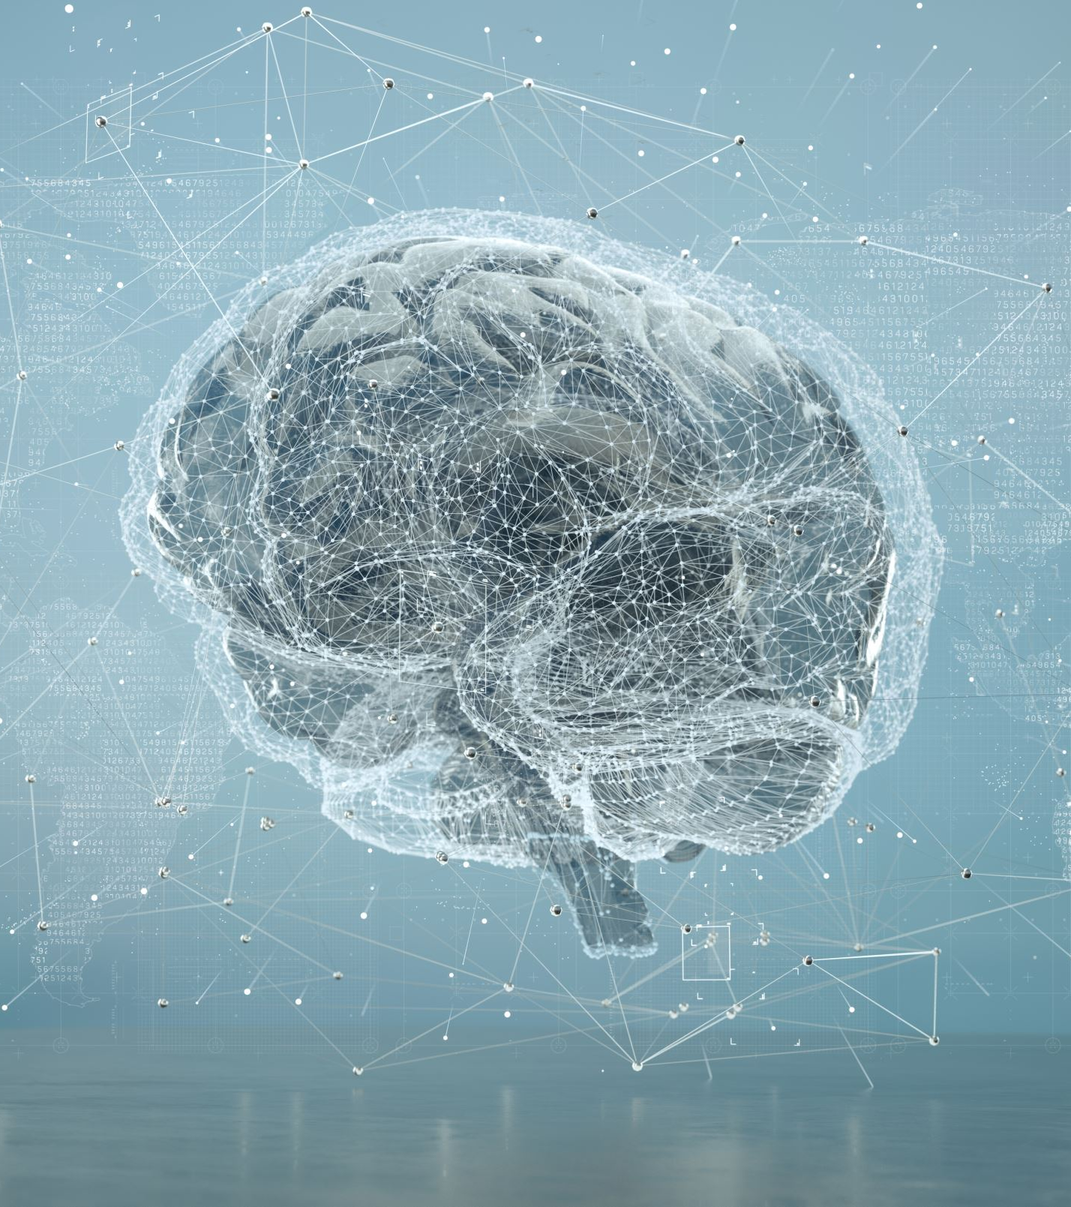
Artificial Intelligence
Simulation of human intelligence by machines.
Wide range of tasks like learning, reasoning, problem-solving, perception, and language understanding.
AI systems are designed to make decisions and automate processes.
Some AI systems can even adapt their models based on new data they process.

Slide 16

Machine Learning
Subset of AI that focuses on developing algorithms that enable machines to learn from data, and improve their performance over time without being explicitly programmed.
Instead of following a fixed set of rules, ML systems identify patterns and make decisions based on data.

Slide 17
Types of Machine Learning
Supervised Learning
Learning from labeled data (input-output pairs)
Examples:
Spam detection
Image classification
Unsupervised Learning
Learning from unlabeled data, identifying hidden patterns or structures withing the data.
Examples:
Customer segmentation in marketing
Fraud detection

Slide 18
Other Types of AI Subfields
Natural Language Processing NLP
Computer Vision
Deep Learning (subset of machine learning based on neural networks)

Slide 19
Quick Quiz!
What is the main difference between supervised and unsupervised learning?
Give two examples of AI in everyday technology.
Name one application of supervised learning and one of unsupervised learning.
Notes:
What is the main difference between supervised and unsupervised learning? Answer: Supervised learning uses labeled data (input-output pairs) to train models, while unsupervised learning identifies patterns or structures in unlabeled data.
Give two examples of AI in everyday technology. Answer: Virtual assistants (e.g., Siri, Alexa) and facial recognition systems.
Name one application of supervised learning and one of unsupervised learning. Answer:
Supervised learning: Spam detection
Unsupervised learning: Customer segmentation

Slide 20
Everyday Business Applications of AI
Customer Service
Chatbots and virtual assistants for 24/7 support
Marketing and Sales
Personalized recommendations
Predictive analytics for customer behavior
Finance
Fraud detection and credit scoring
Algorithmic Trading
Operations & Supply Chain Management
Inventory Optimization
Predictive Maintenance for Equipment

Slide 21
AI in Everyday Technology
Virtual Assistants
Predictive Text and Autocorrect
Facial Recognition
Content Recommendations
Content Curation
Chatbots
Photo and Video Filters
Shopping Recommendations
Chatbots for Customer Service
Fraud Detection
Navigation Apps
Ride Sharing Services
Autonomous Vehicles
Fraud Detections
Robo Advisors
Robo Traders
Credit Scoring
Healthcare Diagnostic Tools
Health Monitoring Apps
Virtual Health Assistants
Spam Filters

Slide 22
Changing Role of Business Professionals
Decision-making
Using AI insights for better business strategies
Automation
Understanding how AI streamlines workflows
Collaboration
Working with data scientists and IT teams to implement AI
Ethical Considerations
Recognizing biases and ensuring ethical AI use
Competitiveness
Staying ahead by leveraging AI-driven tools

Slide 23
Data-Driven Insights for Businesses
Predictive Models
Forecasting sales trends and demand
Sentiment Analysis
Gauging customer feedback from reviews or social media
Optimization
Pricing strategies based on competitor analysis
Market Segmentation
Identifying niche customer groups for tailored campaigns

Slide 24
Ethical Implications - Bias
AI can inherit biases based on data they are trained on leading to discriminatory outcomes.
Example: hiring which will favor certain demographics, facial recognition systems that perform poorly for certain racial or ethnic groups.
Discussion topic: How do we ensure fairness and inclusivity in AI decision-making?
Notes:
Imagine you apply for a job, and instead of a person reviewing your application, an AI decides whether you are qualified or not. How would you feel about that?
What if AI in the workplace decided promotions, project assignments, or even layoffs – how should we ensure this process is fair?

Slide 25
Ethical Implications – Privacy Concerns
AI relies on vast amounts of personal data.
Collecting this data may raise concerns about surveillance and misuse.
Examples:
AI systems tracking online behavior for targeted ads
Governments using AI for mass surveillence
Discussion topic: How do we balance innovation with protecting individual privacy?
Notes:
Imagine a company develops an AI-powered device that monitors employees’ productivity by tracking keystrokes, webcam activity, and emails. This technology should boost efficiency but at what cost to personal privacy?

Slide 26
Accountability and Transparency
AI systems function as “black boxes” making their decisions difficult to understand.
Examples:
Autonomous vehicles making life-or-death decisions in accidents.
Credit scoring algorithms denying loans without clear explanations
Discussion topic: Who is responsible when AI systems make mistakes or cause harm?
Notes:
Who should be held accountable when an AI makes a mistake – like rejecting a qualified candidate or unfairly rating someone’s performance?
Do companies have a responsibility to explain how AI decisions are made?

Slide 27
Job Displacement
Automation and AI-driven systems can replace human workers, leading to unemployment and economic inequality.
Examples:
AI automating roles in manufacturing, customer service, and logistics.
Reduced demand for certain skill sets due to AI advancements.
Discussion Topic: How do we reskill workers and ensure equitable job opportunities?
Notes:
Imagine your job is replaced by an AI tomorrow. What kind of training or support would you need to find a new opportunity?
Should governments or private companies bear the responsibility for funding reskilling programs?
What types of new jobs are being created by AI and automation, and how can we prepare workers for them?

Slide 28
Manipulation and Misinformation
AI-generate content such as deepfakes, can spread misinformation or manipulate public opinion.
Examples:
Fake videos or audio clips used to harm reputations or influence elections
Social media algorithms amplifying false or biased information.
Discussion topic: How do we detect and counteract AI-generated misinformation?
Notes:
What makes AI-generated misinformation (e.g., deepfakes, fabricated text, or fake news) so difficult to detect?
How can we educate people to critically evaluate the information they consume?
What role do governments, companies, and individuals play in combating misinformation?

Slide 29

Ethical AI
Transparency: Clear understanding of how systems work
Regulations: Policies to govern AI development and deployment
Collaboration: Multidisciplinary efforts involving technologists, ethicists, and policymakers
Accountability: Assigning responsibility for AI outcomes

Slide 30

How Can You Get Started?
Learn the basics: Understand key AI and ML concepts
Leverage Tools: User-friendly AI platforms (Tableau, Power BI)
Collaborate with Experts: Partner with a Data Science Team, Participate in an Open Source project
Stay Informed: Keep up with industry Trends

Slide 31
Setting up Scikit-learn

Slide 32

If you have trouble in the first class…
It’s ok! We’re just going to start with some python basics.
Email me after class with any issues that you might be having.
https://www.online-python.com/
Try using this in the meantime!

Slide 33
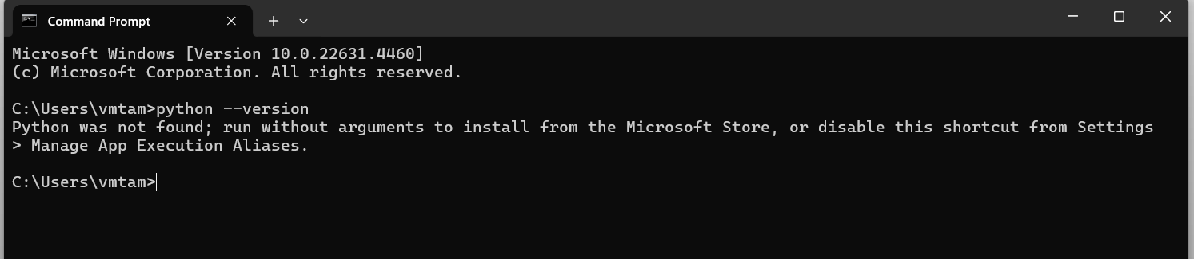
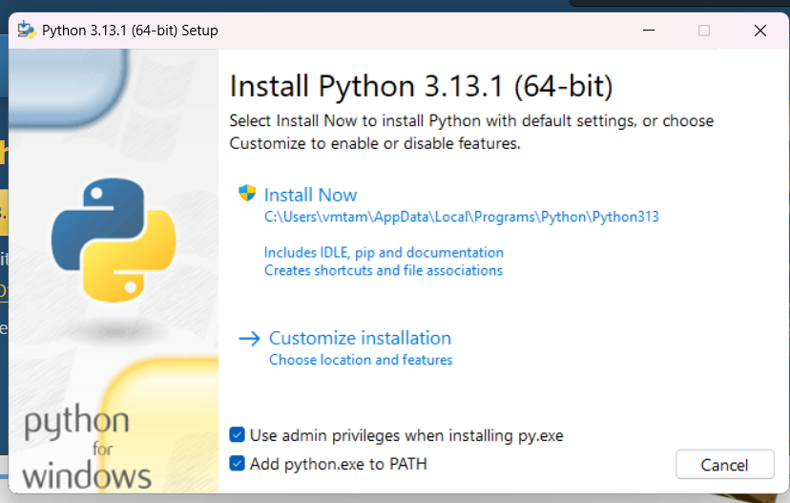
Step 1: Install Python (if not already installed)
Before proceeding with installation of any packages, ensure that Python is installed on your system. You can check if it’s already installed by running
python –version
If python is not installed, you can download it from python.org

Slide 34
Step 2: Install Jupyter Notebook
If you don’t already have Jupyter Notebook installed, you can install it using pip (Python’s package installer)
pip install notebook

Slide 35
Step 3: Install Scikit-learn
To install scikit-learn run the following command in your terinal
pip install scikit-learn

Slide 36
Step 4: Launch Jupyter Notebook
Once Jupyter Notebook and scikit-learn are installed, you can launch Juptyer by running
jupyter notebook
This will open Jupyter in your web browser.
Create a folder directory on your PC for this course.

Slide 37
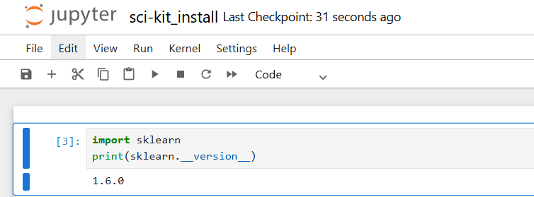
Step 5: Import Scikit-learn in a Notebook
After opening Jupyter Notebook, create a new Python notebook and try importing scikit-learn to make sure it’s installed correctly

Slide 38
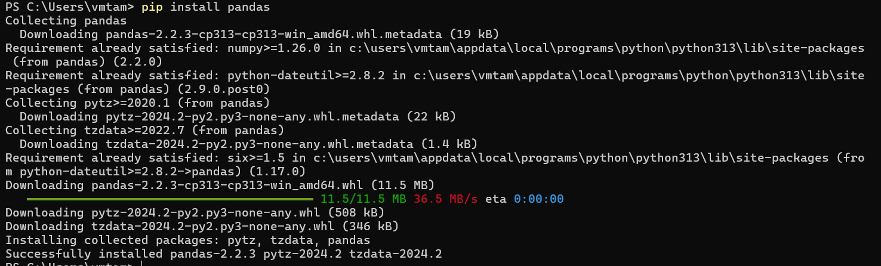
Step 6: Install common packages
You will need to be comfortable installing certain packages. Attempt to install the following common packages using the below command
pip install pandas
Repeat for numpy, matplotlib, imageio, mglearn

Slide 39
Tools Overview

Slide 40
Python Intro
Python Programming Language
w3schools Intro
Used for
Server Side Web Development
Mathematics
System Scripting and automation
Capabilities
Handling big data and complex analytics
Connection to databases and file modification
Syntax Notes
Indentation matters!
Designed for readability
No semicolons – new lines complete a command

Slide 41
Jupyter Notebook
How to Use Jupyter Notebook in 2024: A Beginner’s Tutorial
Web-based IDE that blends the code and the output
Code is placed in a window, and the results are printed immediately, which is essential for data exploration, testing, and sharing of insights

Slide 42
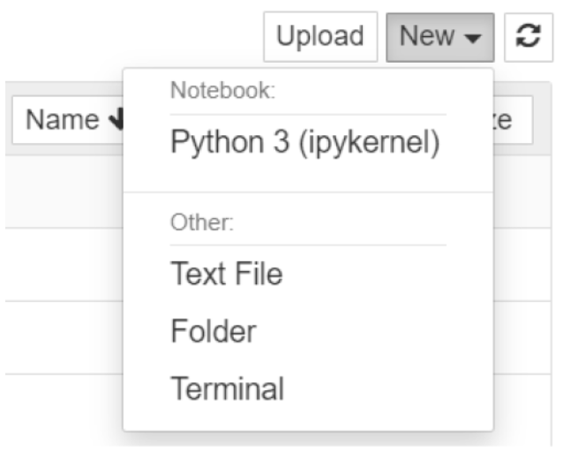
Create a new Jupyter Notebook
Select the directory you want to save the file in
Click New > Python 3 (ipbykernel)
Click ‘Untitled’ at the top, give the file a name, and save it

Slide 43
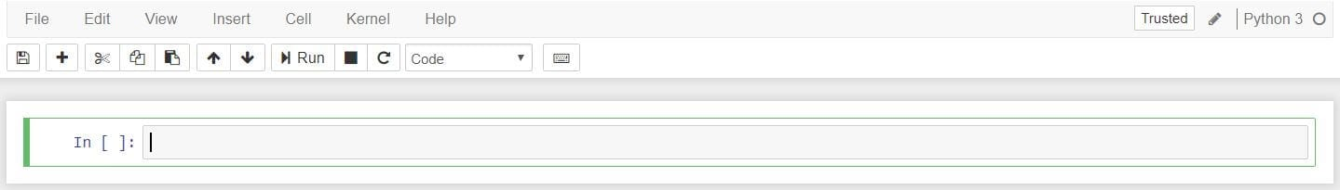
Notebook Interface
Two terms in the Menu Bar to know: Cell and Kernel
Cell: block or section where you write your code or text. The code you write will be executed. Cells help organize work in your workbook
Kernel: computational engine that runs your code. When you write the code in the cell, it processes it and returns the results.
To run the code you can either click into the cell and hit run, or click ctrl + enter

Slide 44
Package: Scikit-learn
Getting Started — scikit-learn 1.6.0 documentation
Open Source Machine Learning Library
Supports Supervised and Unsupervised Learning
Included Tools
Model Fitting
Data Preprocessing
Model selection
Model Evaluation

Slide 45
We need to walk before we run!
Python basics

Slide 46

Classification

Slide 47
Classification Definition
Task of “classifying things” into categories.
Classification is part of “Supervised Machine Learning”
Provide data with an input, and an output
For example: These flowers have x measurements, and they are classified as a y species of that flower.
Machine learning algorithm is trained on this labeled dataset to predict the class or category of new, unseen data
Y = f(x)
The goal is to create a classification model that can make future predictions

Slide 48
Classification Types
Two main types of classification in ML
Binary Classification
Multi-class Classification

Slide 49
Binary Classification
Categorizing data into two distinct classes or outcomes
Yes/No, True/False, Positive/Negative
Examples:
Spam Detection
Medical Diagnosis
Sentiment Analysis
Common Algorithms
Logistic Regression
Support Vector Machines
Naïve Bayes
Neural Networks

Slide 50
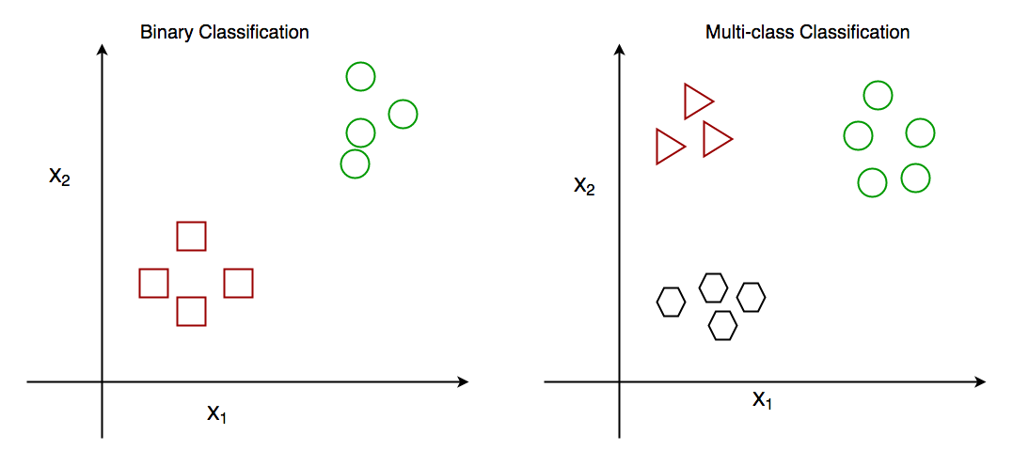
Multi-Class Classification
Categorizing data into three or more distinct classes. Each data point can only belong to one category.
Examples:
Image recognition
Handwritten Digit Recognition
Product Categorization
Common Algorithms for Multi-Class Classification
Decision Trees (e.g., Random Forests)
K-Nearest Neightbors
Naive Bayes

Slide 51
Quick Quiz!
True or False
Classification models are used to train unlabeled data.
Binary classification only involves two possible classes for each data point.
Multi-class classification can handle situations where each data point belongs to more than one category.
Sentiment analysis is an example of a binary classification task.
Notes:
Classification models are used to train unlabeled data. False
Binary classification only involves two possible classes for each data point. True
Multi-class classification can handle situations where each data point belongs to more than one category. False
Sentiment analysis is an example of a binary classification task. True

Slide 52
Machine Learning Classification Techniques

Slide 53

Decision Trees and Random Forests

Slide 54
Decision Trees
Flow-Chart structure used to make decisions or predictions
Decision Nodes
Represent decisions or tests on various attributes of the data
Root node represents the initial decision to be made.
Internal nodes represent the decisions or tests on attributes
Branches
Represent the outcomes of these decisions
Leaves
Representing the final outcomes or decisions

Slide 55
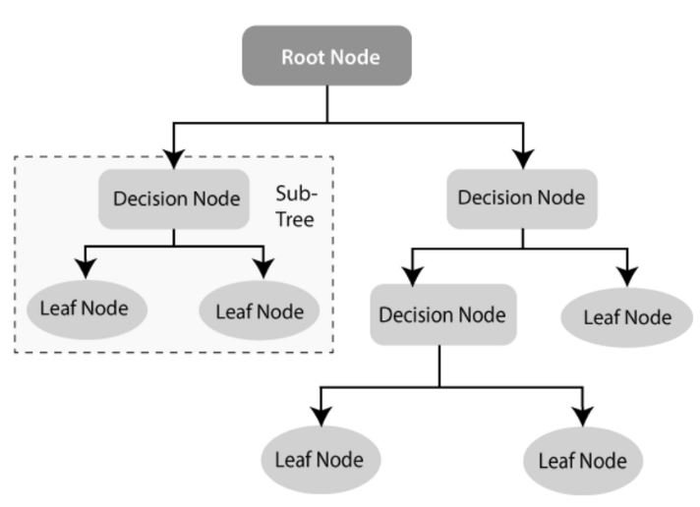

Slide 56
Branch Splitting
Determines the branch path (Yes/No) based on statistical metrics
Gini Impurity
How often a randomly chosen element would be incorrectly classified
Entropy
Degree of disorder or uncertainty

Slide 57
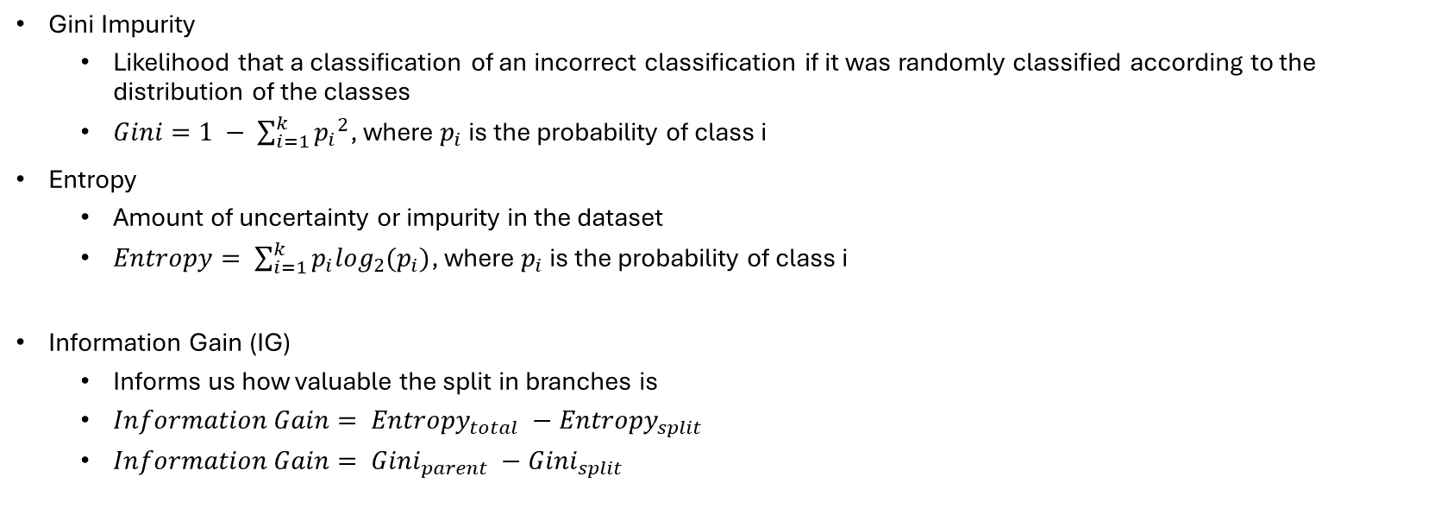
Metrics for Splitting Branches
Gini Impurity
Likelihood that a classification of an incorrect classification if it was randomly classified according to the distribution of the classes
$Gini=1 − \sum_{i=1}^{k}{{p_{i}}^{2}}$, where $p_{i}$ is the probability of class i
Entropy
Amount of uncertainty or impurity in the dataset
$Entropy= \sum_{i=1}^{k}{p_{i}\log_{2}(p_{i})}$, where $p_{i}$ is the probability of class i
Information Gain (IG)
Informs us how valuable the split in branches is
$Information Gain= {Entropy}_{total} −{Entropy}_{split}$
$Information Gain= {Gini}_{parent} −{Gini}_{split}$

Slide 58
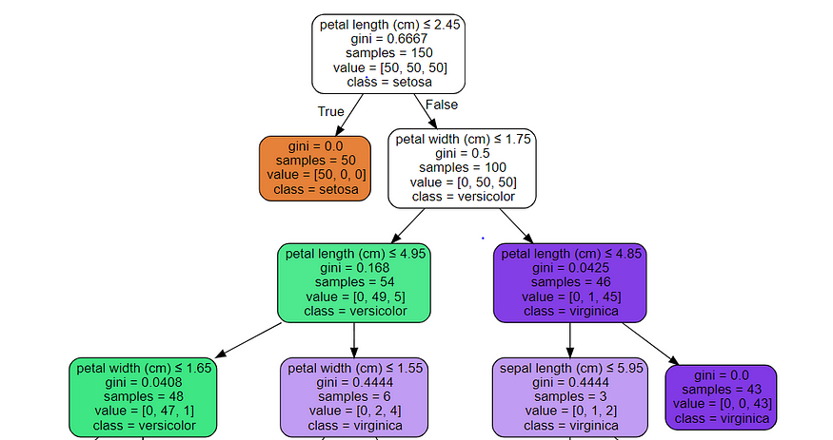

Slide 59
Pros and Cons of a Decision Tree
Pros
Easy to understand
Handles categorical and numeric data
Cons
Prone to overfitting
Sensitive to small changes

Slide 60
Random Forest
Ensemble learning method primarily used for classification and regression tasks.
The theory is that combining many weak models (individual decision trees) can produce a more robust and accurate model.
Bootstrapping
Creating multiple subsets of the training data by selecting data points with replacement. (Some data points may appear in more than one sample)
Building multiple decision trees
Uses random selection of features (encourages diversity among trees)
Each Tree is grown to a maximum depth without pruning.
Combining Results
Final prediction is the made by the majority vote for classification tasks.
For regression tasks, the prediction is the average of all tree predictions.
Notes:
Random Forest: A Complete Guide for Machine Learning | Built In

Slide 61
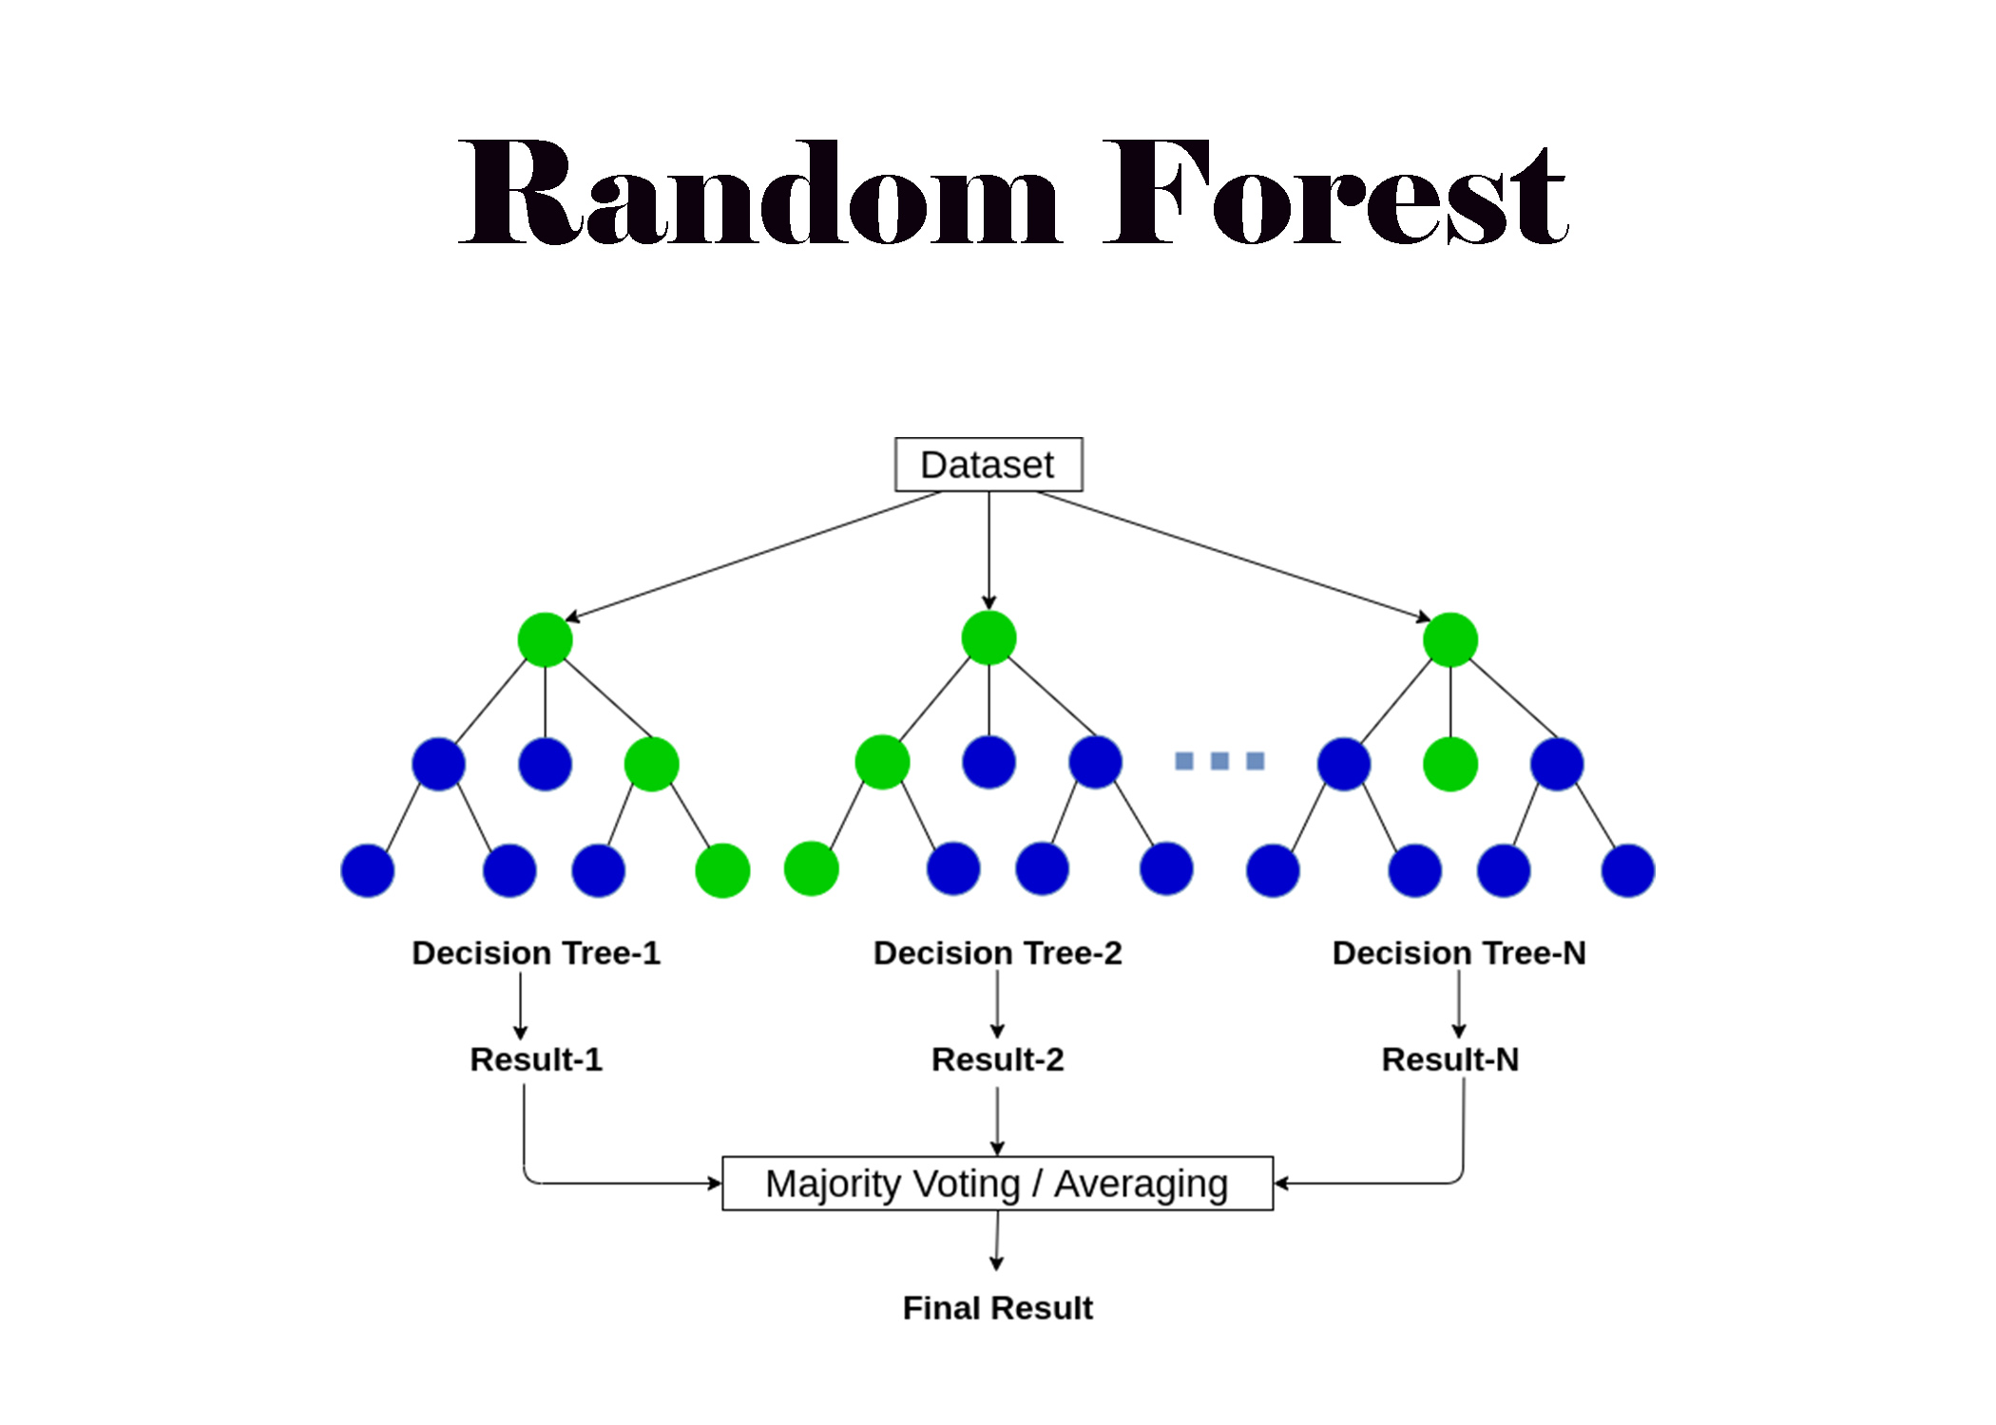

Slide 62
Quick Quiz!
Explain the concept of bootstrapping in a Random Forest.
How does a Random Forest make predictions for regression tasks?
What role does Gini Impurity play in decision tree branch splitting?
Notes:
Explain the concept of bootstrapping in Random Forest. Answer: Bootstrapping involves creating multiple subsets of training data by selecting data points with replacement, allowing the same data points to appear in more than one subset.
How does Random Forest make predictions for regression tasks? Answer: It calculates the average of all tree predictions.
What role does Gini Impurity play in decision tree branch splitting? Answer: Gini Impurity measures how often a randomly chosen element would be incorrectly classified, helping to determine the optimal branch split.

Slide 63
Nearest Neighbors Algorithm
Also known as k-Nearest Neighbors (k-NN)
Simple learning algorithm for both classification and regression.
Finds the k nearest data points to a query point by making predictions based on their characteristics. You can define what k is.
For classification, it assigns the most frequent class label among these neighbors, and for regression it averages the k nearest neighbors.

Slide 64
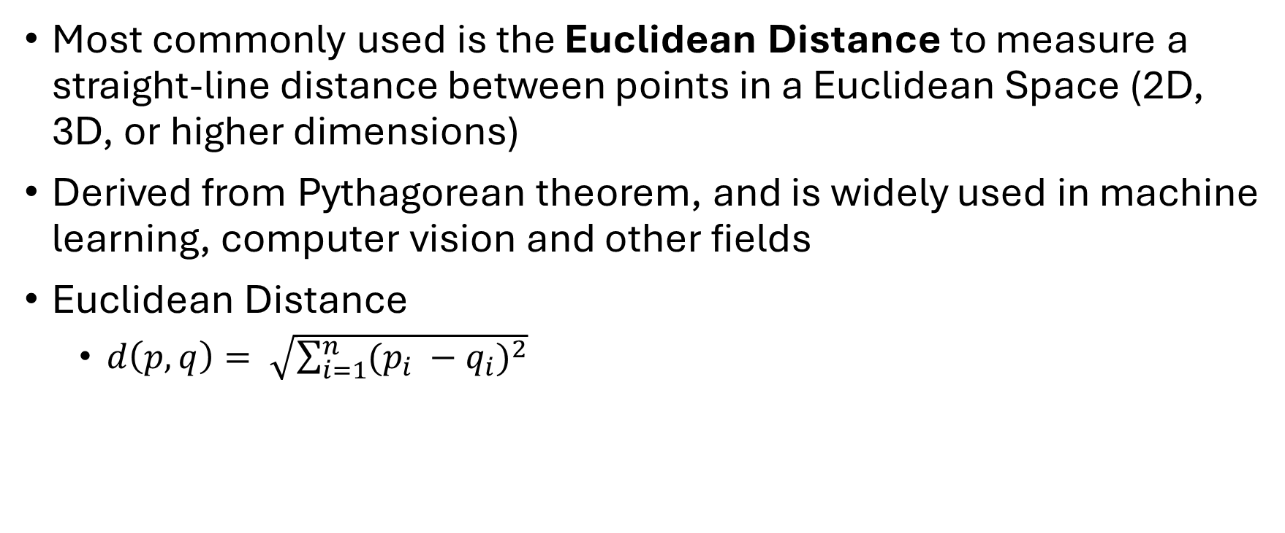
Distance Metric for k-NN Algorithm
Most commonly used is the Euclidean Distance to measure a straight-line distance between points in a Euclidean Space (2D, 3D, or higher dimensions)
Derived from Pythagorean theorem, and is widely used in machine learning, computer vision and other fields
Euclidean Distance
$d\left(p, q\right)= \sqrt{\sum_{i=1}^{n}{{(p_{i} −q_{i})}^{2}}}$

Slide 65
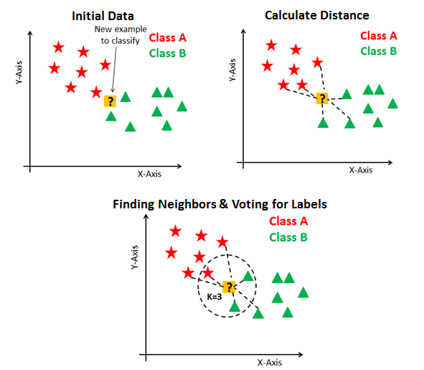

Slide 66

Typical Machine Learning Pipeline
Preprocessing Step
Transforms or cleans data
Final Predictor
Prediction of target values
Model Evaluation
Test to validate the accuracy of the model

Slide 67
Iris Dataset
Famous dataset used in machine learning and statistics for classification tasks.
Contains measurements of iris flowers from three different species.
Setosa
Versicolor
Virginica
We will use k-NN to classify iris flowers based on their measurements.
150 samples with 4 features each
Sepal Length
Sepal Width
Petal Length
Petal Width
Notes:
load_iris — scikit-learn 1.6.0 documentation
7.1. Toy datasets — scikit-learn 1.6.0 documentation
The Iris Dataset

Slide 68
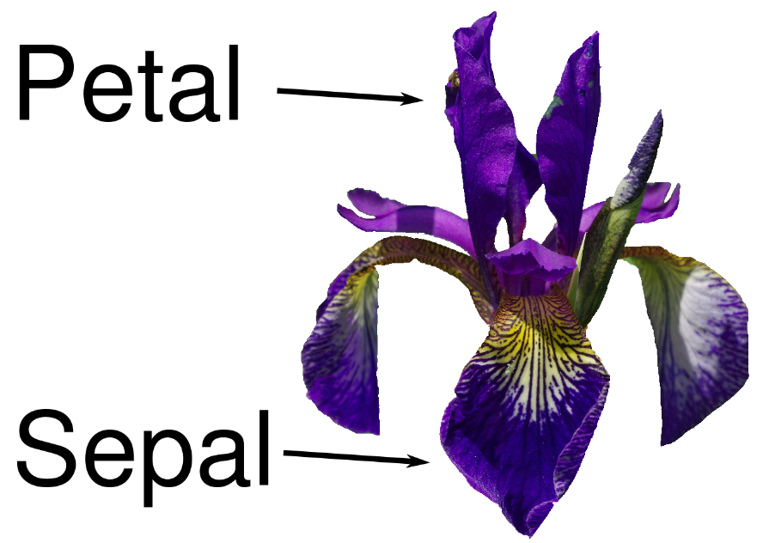

Slide 69
Resources
Data Science vs Data Analytics - GeeksforGeeks
Python Ml Decision Tree - Complete Guide – MrExamples
Random Forest: A Complete Guide for Machine Learning | Built In
load_iris — scikit-learn 1.6.0 documentation
7.1. Toy datasets — scikit-learn 1.6.0 documentation
The Iris Dataset
Notes:
load_iris — scikit-learn 1.6.0 documentation
7.1. Toy datasets — scikit-learn 1.6.0 documentation
The Iris Dataset

